Slide 1

Mini project Presentation SESSION 2021-22
Department of CEIT
ABES Engineering College, Ghaziabad, U.P.
Team Name : Tech Republic
Branch & Year : Computer Engineering(3rd Year)
Member Name: University Roll No: Admission No:
Chirag Singh 1900320150015 2019B151041
Satyam Gupta 1900320150045 2019B151054
Dhruv Sehgal 1900320150016 2019B151035

Slide 2
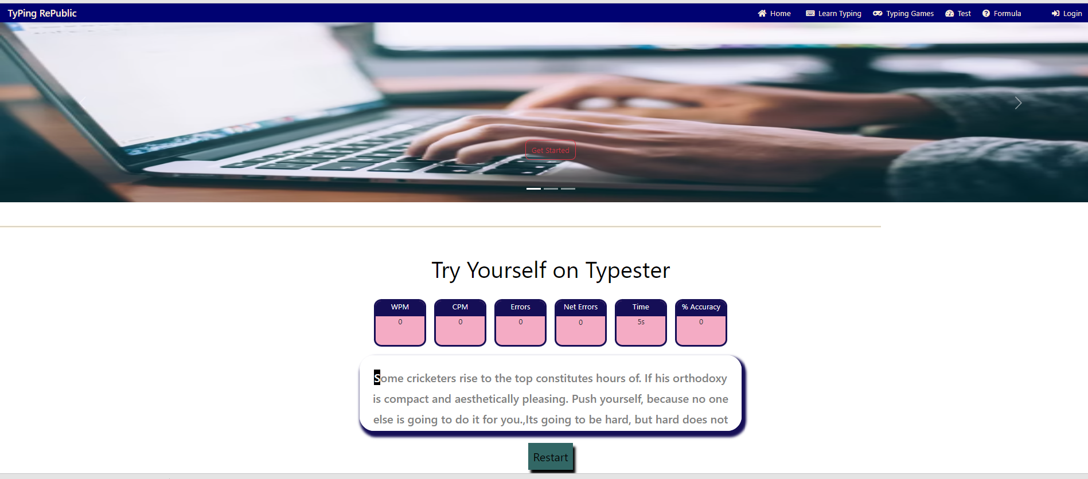
Universal typing MASTER

Slide 3
Project description
It is a website that measures the speed of QWERTY Keyboard Typing .
Speed is typically measured in WPM (Words Per Minute).
It measures accuracy.
It also measures CPM, Error, Net Error .
It helps us to increase our typing speed.

Slide 4
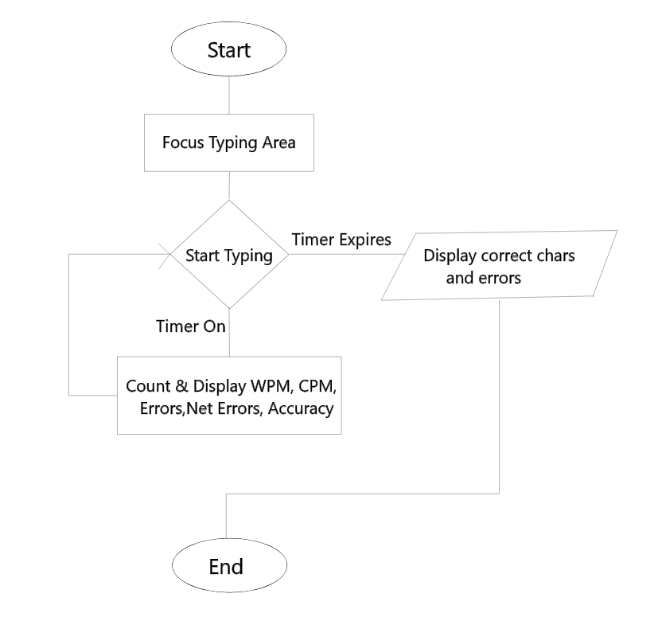
Project flowCHART

Slide 5
Technology used
HTML
CSS
Bootstrap
Javascript

Slide 6
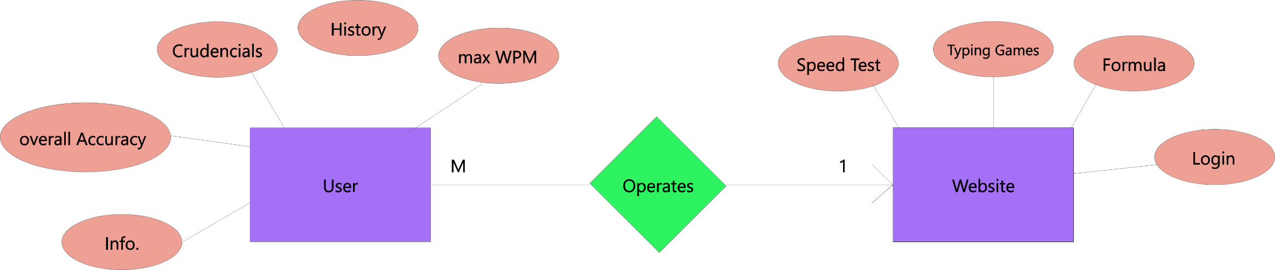
Er diagram

Slide 7
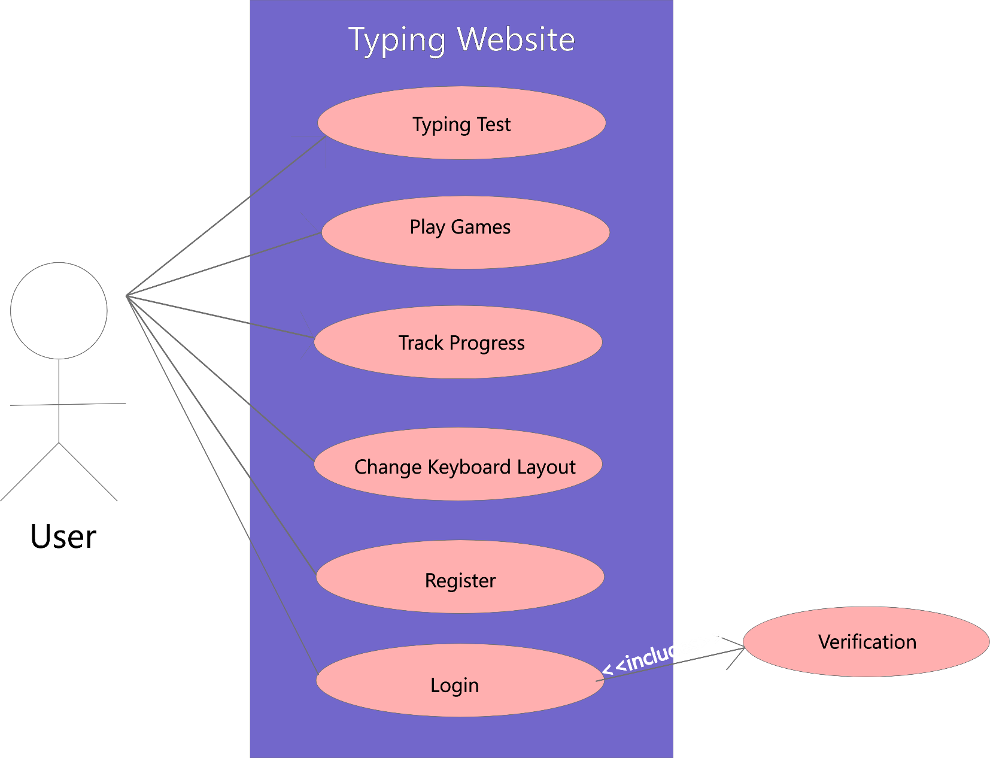
Use case diagram

Slide 8
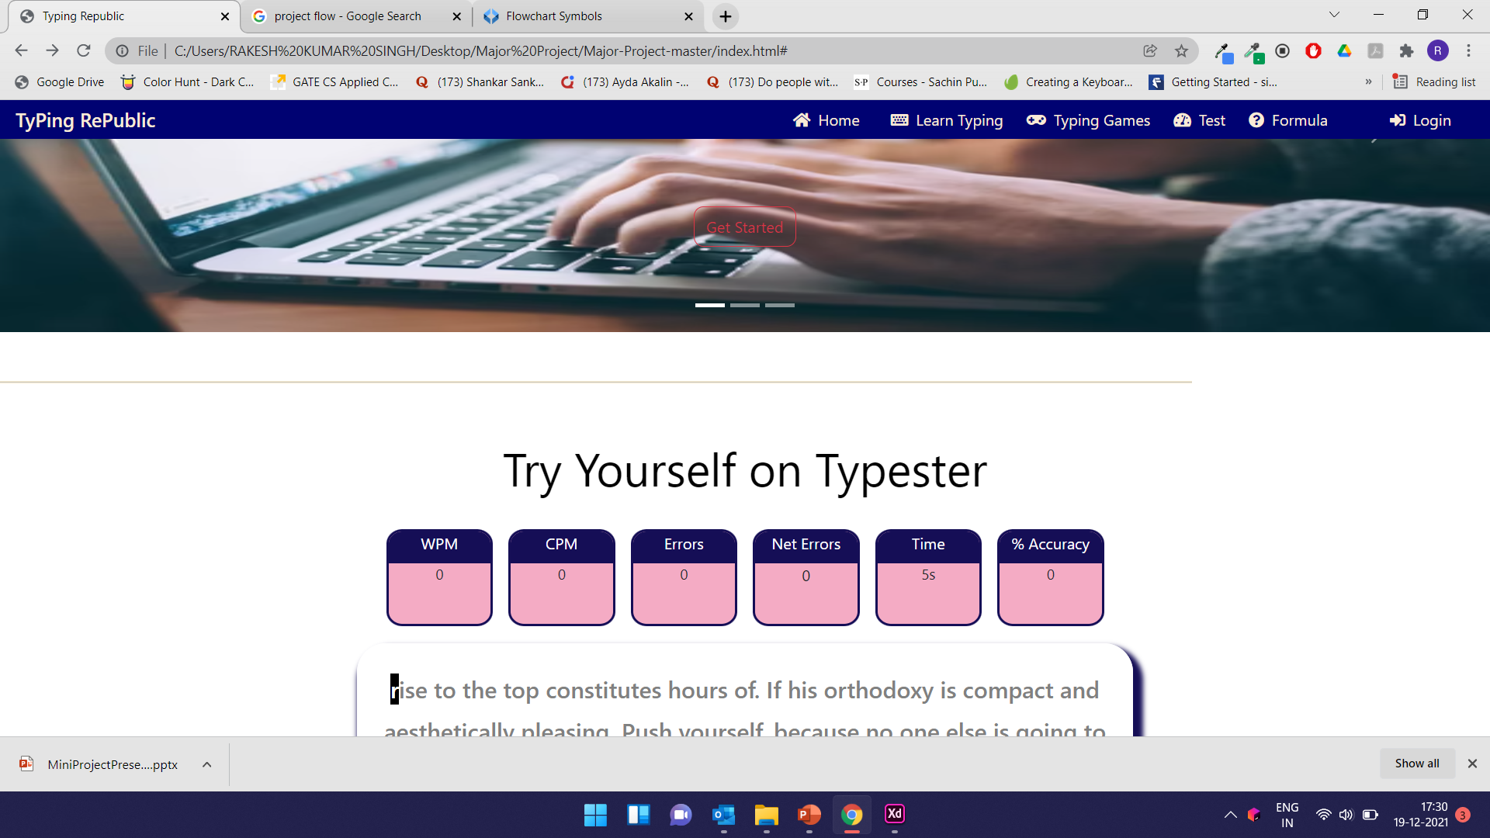
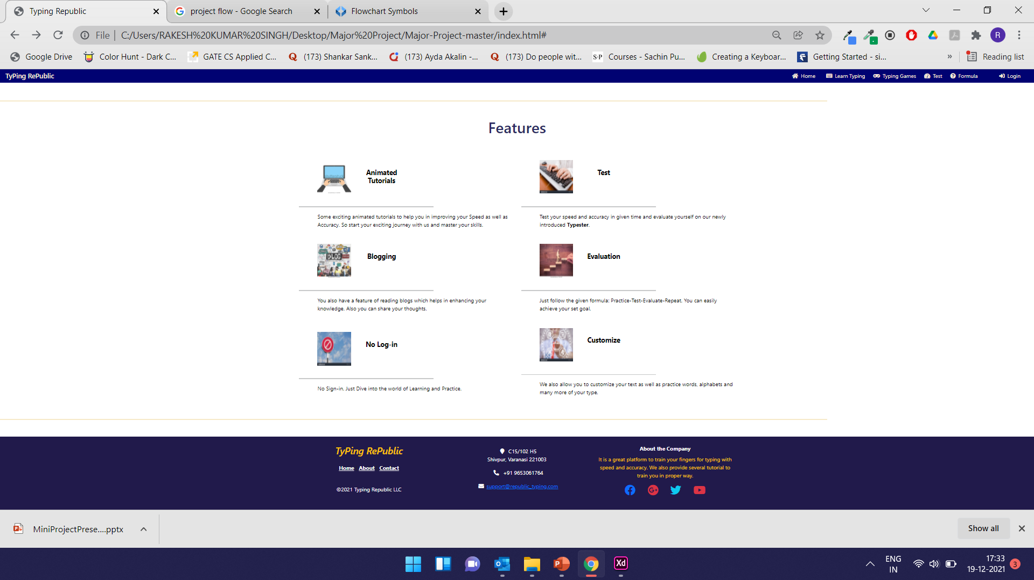
Screens

Slide 9


